Slide 1
Project SoreVisionTM
Raj anantharaman,
cs5542 – spring 2017

Slide 2
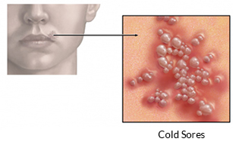
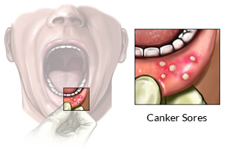
PROBLEM STATEMENT
Mouth Sores are quite a common occurring and can show up inside the mouth, on the gums, on or around the lips, or totally outside of the mouth.
Most people do not realize that mouth sores come in two varieties.
One variety of mouth sore, referred to as the “cold sore” is highly contagious while the other variety of mouth sore, referred to as a “canker sore” is luckily not contagious.

Slide 3
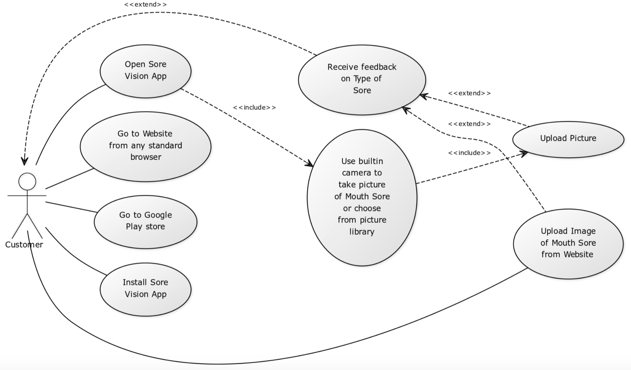
OUR SOLUTION – SORE VISIONTM
“Sore Vision” is an HTML5 mobile responsive web app that can aid a person in identifying the kind of mouth sore.
The person simply takes a picture and presents it to Sore Vision.
Sore Vision uses deep learning to identify, classify and provide immediate feedback with a certain degree of confidence.

Slide 4
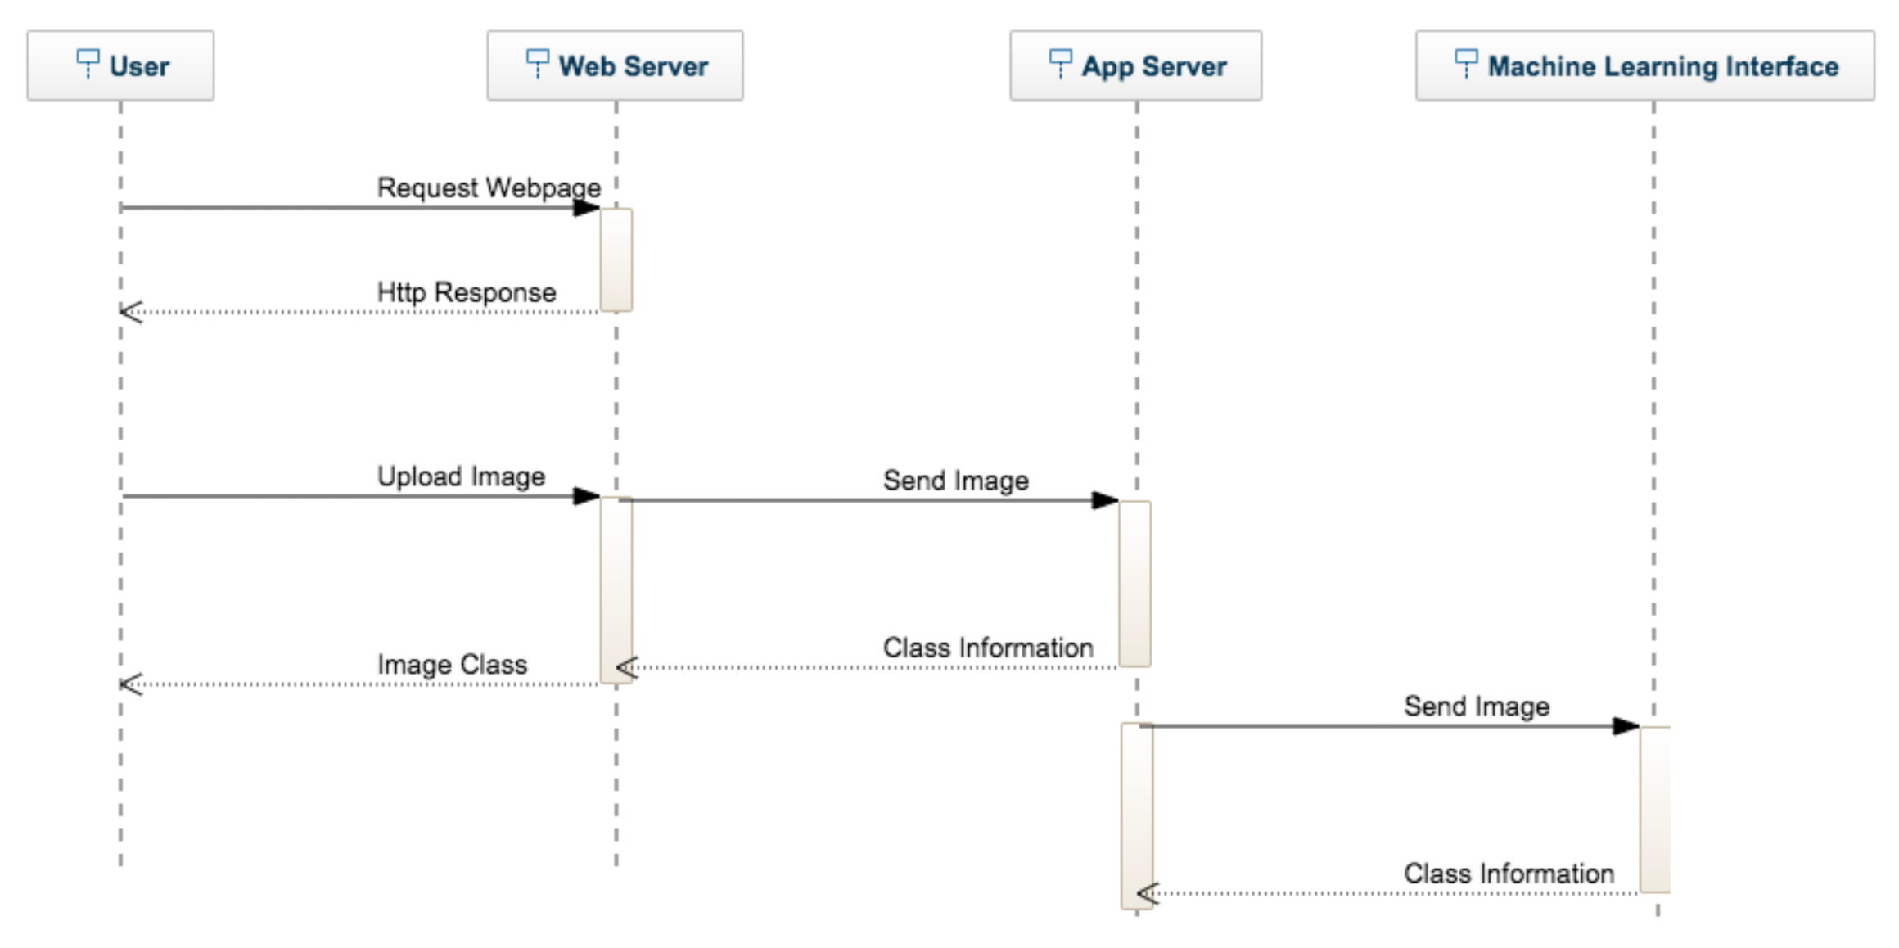
Application Architecture

Slide 5
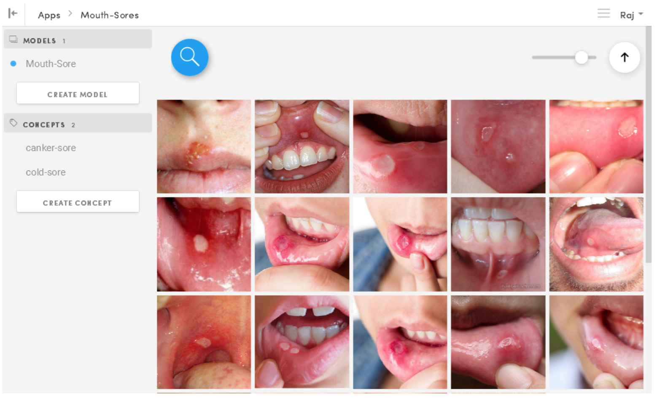
Technical Approach
Web UI using HTML5 and JQuery
Java based and Python based Simple HTTP Servers
Clarifai API
Retraining last layer of Inception Model
Machine Learning (Spark Mllib)
75 training images from Google Images

Slide 6
Results
The Test data set consisted of 6 images that were totally new and the models had no prior exposure to these images
Test data was classified by three different means
A Human dentist
Clarifai API
Retrained Inception Model
Clarifai performed the best, followed by Retrained Inception.
Spark Mllib performed the worst and is not included in the final results because of sub par performance
Image | Dentist | Inception | Clarifai
1 | Cold – 100% | Cold – 89.88% | Cold – 86.59%
2 | Canker – 100% | Cold – 72.73% | Canker – 77.25%
3 | Cold – 100% | Cold – 99.37% | Cold – 94.79%
4 | Cold – 100% | Canker – 59.01% | Cold – 93.37%
5 | Cold – 100% | Cold – 95.52% | Cold – 93.73%
6 | Canker – 100% | Canker – 96.22% | Canker – 92.59%

Slide 7
This work was done in partial fulfillment of the requirements of CS5542: Big Data Analytics and Apps, CSEE Department, University of Missouri – Kansas City (Spring 2017).
Instructors:
Dr. Yugyung Lee,
Chandra Shekar, Mayanka
Tas
Maddula, Manikanta,
Peddinti, Sudhakar Reddy,
Vadlamudi, Naga K.

